Slide 1
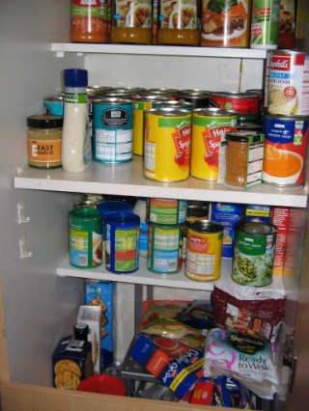

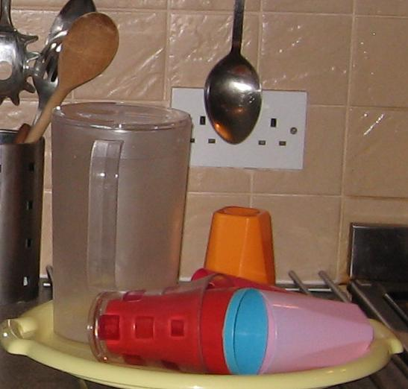
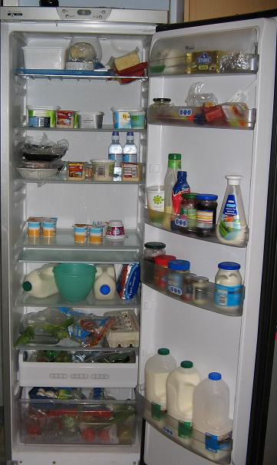
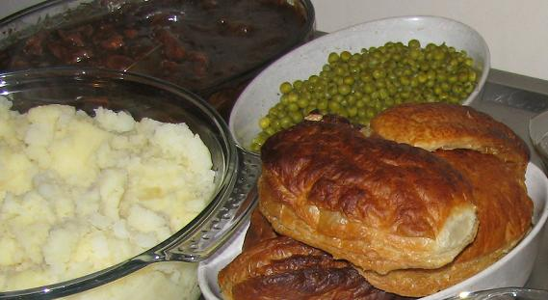
Food for Thought and Intersectionality:
Opportunities and Challenges of Collaboration between Research, Policy and Practice
Samantha Punch, Ruth Emond and Ian McIntosh
School of Applied Social Science
s.v.punch@stir.ac.uk
Notes:
Two key aims
Introduce the research project and some key findings using the lens of intersectionality
Talk briefly about the follow-on impact work we have been doing working in partnership
= To lead into a discussion on the Opportunities and Challenges of Collaboration between Research, Policy and Practice

Slide 2
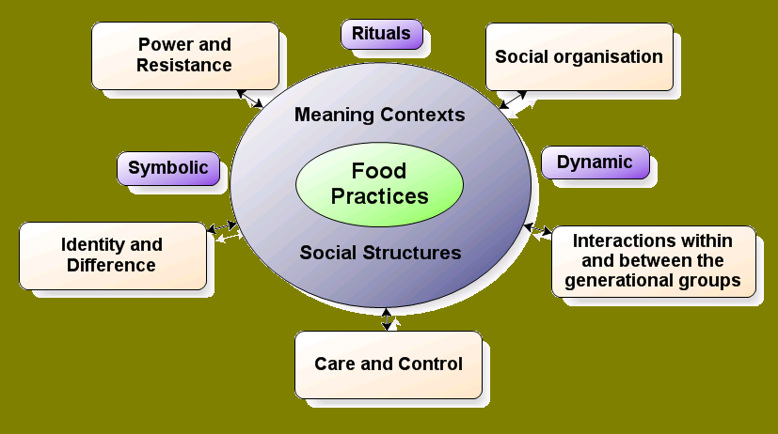
Research Aims

Slide 3
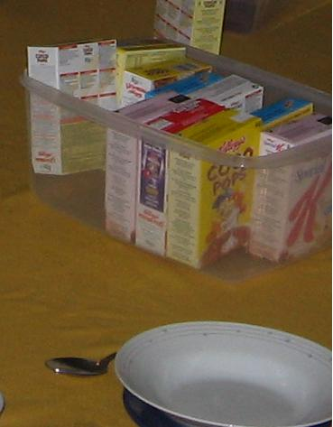
Design and Methods
Fieldwork: conducted between Jan 07 and Mar 08: 3 x 12 weeks participant observation + group and individual interviews
Participants: Staff and children of 3 residential units
        Wellton
        6 children, 9-13 years
        Highton
        8 children, 12-16 years
        Lifton
        6 children, 14-18 years
21 children (14 boys and 7 girls) resided at the homes in the course of the fieldwork.
16 children (11 boys and 5 girls) and 46 members of staff (26 women and 20 men) participated in an individual interview and/or a focus group.

Slide 4


Key Themes
Mealtimes
Negotiating ‘Home’, ‘Institution’ and Workplace
Food and Relationships
Food, Care and Control
Feelings, Conflict and Resistance
Power and Empowerment
Notes:
And all of these can be looked at in relation to children’s rights….
Translating children’s rights into practice is associated with different understandings of the nature of adult-child relations as well as linked to the tensions involved in striking a balance between children’s protection and participation rights.

Slide 5
Intersectionality and Children in Care
We need to understand the potential for discrimination towards, and the lack of agency of, children in care as resulting from a combination of factors in dynamic interplay:
being a child
being stigmatized through being in care
being poor and often working class
with an identity that is often problematized through state interventions and living outside of the family

Slide 6


Mealtimes: Key Site of Ambiguity and Ambivalence
Notes:
Seen ambivalently as both positve and negative time of the day by both staff and children
By focusing on one example of mealtimes – bringing children and adults together round the table, this illustrates the complexities of putting a theory of children’s rights into practice within the everyday contexts of residential child care, where children have this interplay of gender, class, age and care status coming together…
So by looking at the routines of food provision and consumption we can see that a reflection on intersectional power relations and identities brings to light the challenges of operationalizing children’s rights.

Slide 7
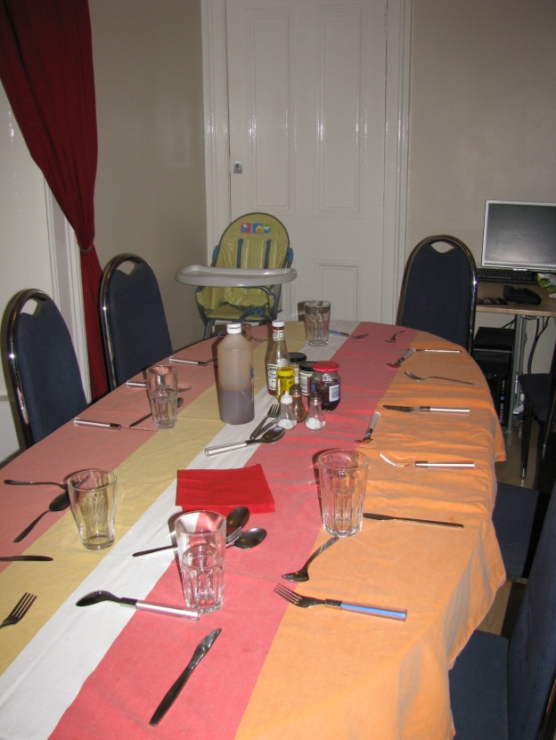
7
Mealtimes
children’s welfare rights
Compulsory to sit at the table
Teaching manners and behaviour
Controlled portion sizes
= adults’ perceived best interests of ‘the child’
Ethos = needs, responsibilities and control rather than autonomy, choice and self-determination
Notes:
At one residential unit (Wellton) staff tended to respond more to children’s welfare rights rather than their rights to self-determination and privacy. As well as teaching children about responsibilities and respect, this approach was intended in the spirit of protecting and caring for them, but it could result in greater regulation
For example, attending mealtimes was not just an expectation but a rule; the children were regularly corrected on their manners and behaviour, adults determined the size of portions and assigned chores and seats to the children.
Thus the staff were acting more in line with adults’ perceived best interests of ‘the child’ rather than viewing children as competent social actors. The ethos of Wellton appeared to be based more around needs, responsibilities and control rather than autonomy, choice and self-determination.

Slide 8
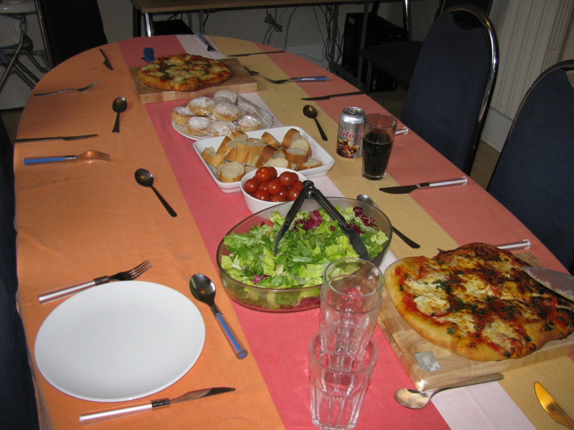
Flexible Rules & Mealtimes
Food routines were flexible
- Attendance at the table was encouraged
Not compulsory to wash hands or do chores
Notes:
Another unit (Lifton) tried to “balancing these rights and responsibilities” in a different way. Emphasis was given to the nurturing of children and the creation of a safe and supportive environment in which adults retained control, yet did so in subtle ways.
Staff tended to operate rules flexibly to maximise opportunities for attuning to individual needs and abilities rather than adhere to regulations or prepare young people for a ‘harsher’ future by imposing routines and limits. For example, whilst knives would be locked away there were no strict hygiene rules such as hand washing before meals, and there were no rules regarding chores after a meal.

Slide 9
Open access to the kitchen
I think the positive side about having an open kitchen is [that they] can have that access without bringing too much attention to themselves and being the focus. They’ve got … privacy to say ‘well I'm gonna make a sandwich’. (Beth, Care Worker)
= emotional needs; rights to privacy and autonomy, cf. concerns over health and safety
Notes:
Lifton’s approach to rights and responsibilities was expressed in young people’s access to the kitchen, where the relaxing of surveillance over this part of the unit was seen to be a powerful symbol of trust between staff and children (McIntosh et al., 2010):
I think the positive side about having an open kitchen is [that they] can have that access without bringing too much attention to themselves and being the focus. They’ve got … privacy to say ‘well I'm gonna make a sandwich’. (Beth, Care Worker, Focus Group, Lifton)
The protection and promotion of children’s wellbeing was here understood in terms of their emotional needs and their rights to privacy and autonomy, which could outweigh concerns over health and safety.
=
Lifton’s view was that rights are addressed and achieved more successfully when rules are flexible and there is a focus on relationship building and creating a sense of belonging to the residential unit

Slide 10

Protection versus
participation rights
Snacks
free access = right to choice and a sense of self-determination, ownership and home
controlled access = in the interest of health, safety and prevention of misuse.
Notes:
Another similar example which illustrates the tensions between protection and participation rights…
is children’s free access to snacks represented the right to choice and a sense of self-determination, ownership and home. However, this could clash with an ethics of care and staff felt a responsibility at times to strictly control access to snacks in the interest of health, safety and prevention of misuse.
Both of these examples show the complexities and difficulties of ‘doing rights’ in practice particularly with a group with multiple intersecting identities coming together
- And this shows that there is a key tension between meeting the often contradictory sets of protection and participation rights

Slide 11
Rights, Intersectionality and Care
intersecting identities may lead to practice dominated by risk prevention and a focus on children’s welfare rights
at the expense of children’s agency and their rights to self-determination
Punch, S., McIntosh, I. and Emond, R. (2012) ‘‘You have a right to be nourished and fed, but do I have a right to make sure you eat your food?’: Children’s Rights and Food Practices in Residential Care’, International Journal of Human Rights, 16(8): 1250-1262.
Notes:
the rights agenda is, arguably, driven by concerns and anxieties regarding children and care as well as by seeking to control risk and making care measurable particularly for children who experience multiple forms of discrimination
Their intersecting identities mean that practice is often determined by risk prevention and a focus on their welfare rights, but if children’s protection rights are focused on too rigidly then there is not enough room to accommodate children’s agency and their rights to self-determination.
The risk is that a rights agenda can end up dominating social interactions rather than facilitating the building of relationships.

Slide 12
Food based training, assessment and intervention tools for carers of looked after young people
Raising awareness of the power of food in understanding and caring for looked after children
Notes:
So after completing the 2 ½ year research project, we got another one year of funding from the Economic and Social Research council to turn the staff handbook into a training package for the carers of looked after young people.
This one year project was focused on knowledge exchange partnership working in order to co-produce the training materials.
3 ‘practice’ partners: Foster Care Associates (core assets), Aberlour Child Care Trust & Perth and Kinross Council
Also in consulatation with CELCIS - Centre for Excellence in Looked After Children in Scotland
Institute for Research and Innovation in Social Services (IRISS) – who developed the website

Slide 13
The Process - in Partnership
Steering Group:
  All partners represented and regular meetings
  Working Group - devising, delivery, evaluation:
  2-3 from each organisation: carers, managers, supervisors
  Aim to develop a variety of training resources
Downloadable free resources:
    http://www.foodforthoughtproject.info/
Notes:
We worked together as a partnership to develop the training resources, then to pilot them and then to roll out the training as much as possible throughout Scotland.
We did this with a Steering group with representatives from all the partners and held regular meetings throughout the year to design each stage of the project
We set up Working groups with a mixture of 2-3 carers, managers and supervisors from each organization – so it was a dialogue between academics and practitioners working together with the aim…
Aim to develop a variety of training resources: which would cater for different learning styles
Lots of time during these sessions to collect feedback and suggestions on the process of partnership working as we are also writing about the process of co-producing these materials (evaluation)
All the resources are available for free at…. And we have copies of this leaflet with us which details each of the resources which I will now go through in turn…

Slide 14
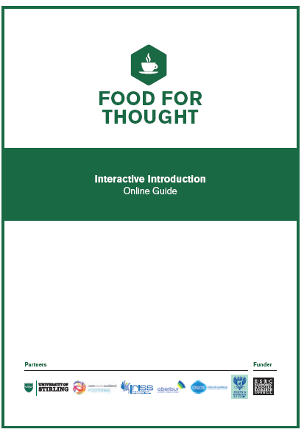
The Resources: Interactive Introduction
INTERACTIVE INTRODUCTION
  Short online introduction to basic concepts
  Raises awareness of food as a symbol
  Individual reflections
Notes:
The Interactive Introduction to Food for Thought is a short online guide which introduces the user to some of the key concepts relating to Food for Thought.
It aims to raise awareness of the symbolic use of food and how this relates to care. Users are asked to reflect on their own experiences and relate these to some of the key findings of our research. So, questions are posed to invite individual reflection on particular food practices and the person using the tool can write in their responses. Then they get a response which includes some of the most interesting findings from our research.
This tool provides a good introduction for those who might then go on to attend a training workshop or for those who would like a refresher in the future, to remind them of some of the key issues surrounding the symbolic meanings of food

Slide 15
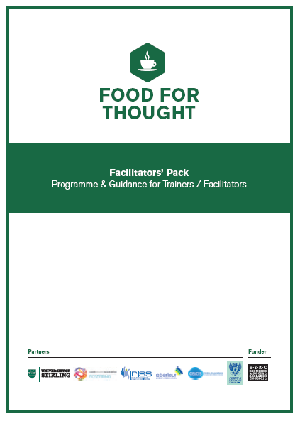
The Resources: Reflective Workshop
  Workshops raise awareness of food as a symbol – in discussion with others
  Support materials for organisations to run own Reflective Workshops
  All PowerPoint slides and Handouts provided
  Free ‘train the trainer’ workshop in September – email Ruth: h.r.emond@stir.ac.uk
FACILITATORS’ PACK
Notes:
We run one full day or two half day Reflective Workshops which aim to raise awareness of the symbolic meanings of food practices (that I have just talked to you about). A key benefit of this is that residential workers or foster carers come together to share their experiences and learn from each other.
The Facilitators’ pack contains all the materials needed to run a Reflective Workshop – including the one day and two half day programmes, an overview of the research, practical guidance to running the workshops, all the powerpt slides and workshop activities for small group working, and all the necessary handouts and case studies.

Slide 16
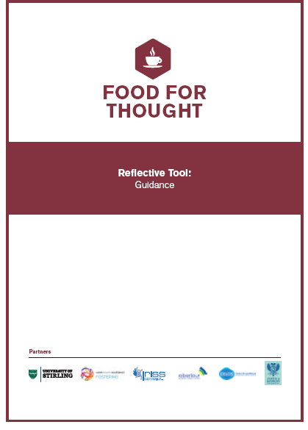
The Resources: Reflective Tool
REFLECTIVE TOOL & GUIDANCE
  Encourages personal reflection on a specific child
  Two available formats
  Confidential to carer/worker
  Useful to identify issues for supervision or peer support discussions
  Separate Guidance notes
Notes:
The Reflective Tool is intended to be used by individual carers or residential workers after they have attended the Workshop or completed the Interactive Introduction.
The Reflective Tool guides users through a series of questions and prompts to create a ‘snap shot’ of their personal food-related interactions with individual children in their care. It is intended that through such reflection, carers working in any context will be more able to articulate issues and understand the significance of their own, as well as the young person’s behaviours, values, expectations and so on.
It is a way to record thoughts and issues about individual children so that progress over time can be seen more easily or discussions with supervisors or support workers can be focussed on specific topics of immediate relevance.
In addition, the Reflective Tool can also be used to encourage reflection prior to foster care support meetings, group supervision discussions or staff meetings. So it can be used as a springboard into discussion with peers/colleagues

Slide 17

The Resources: Peer Support Guidance
PEER SUPPORT GUIDANCE
  Opportunity for group reflection and discussion – builds on other resources
  Links concepts to what is happening day-to-day
  Guidance to support facilitators and supervisors in having focused discussions
  FREE – contact Ruth (h.r.emond@stir.ac.uk)
Notes:
Whilst the Reflective Workshops primarily concentrate on raising awareness and engaging in introductory discussion about the role of food in care, carers and residential workers may need opportunities to discuss these issues in relation to the situations they are facing on a day-to-day basis. So we suggest that Peer Support group sessions will provide an opportunity for carers to talk in more detail about possible solutions and strategies to help individual children/young people.
Peer support groups which focus on food practices provide opportunities to share experiences or concerns about food and to learn with and from others in similar situations. So, Peer Support sessions allow discussion and an opportunity to see how other carers do things and why. They capture a range of views from others. They provide a sense of not being alone, and enables carers to feel less isolated

Slide 18
Using the Resources
Reflective Workshop
Interactive Introduction
Interactive Introduction
JOTIT Notebook
Peer Support
JOTIT Notebook
Reflective Workshop
Reflective Tool
Reflective Tool
Peer Support
Peer Support
Reflective Tool
Notes:
Our intention is that people are more likely to use the interactive introduction first, whilst browsing the website, then go to a reflective workshop, and then use the reflective tool, however it is by no means fixed that it should be in that order. The tools have been designed so that they each stand alone and could be used in any order, so we expect people to dip in and out of them
What we hope that this has shown is that it is increasingly important for academics to try to ensure that their work is applied and useful to non-academics. In particular within Childhood Studies it is important to try to bridge the gap between the academic discourses of children’s rights, children’s participation and children’s agency with the work of practitioners who work with children.
This project begun with research with children and adults in a care setting, and has now tried to adapt its findings to an applied training package which aims to raise awareness around the symbolic meanings of food practices. Ultimately the goal is to improve the lived experiences for children in care, by making their carers more aware of the powerful messages that food can portray.
I have some leaflets about these resources if anyone is interested in knowing more.

Slide 19
Food for Thought and Intersectionality
Food, like intersectionality, is a lens into the complexity of care
Intergenerational relationships are played out through food in different spaces
  - connotations of power, care and control
Notes:
This presentation has already highlighted that by looking at food and the practices around it we can often learn a lot about the ethos underpinning the care being provided, how behaviour of service users is seen and understood, and how individual and group needs are balanced. The extent to which individuals feel part of a group experience or have a sense of belonging to the service can also be explored through how food is used.
By looking and talking about food we can begin to access the complex nature of giving and receiving care. The challenges, dilemmas and emotions involved in the care experience can be explored through food. We have found this offers a ‘safe’ vehicle to explore such issues.
By looking at food we can learn a lot about how individuals are feeling at any given moment in time and how they are managing the expectations, rules and routines of the care setting.
Intergenerational relations are played out through food in different spaces
- connotations of power, care and control which have to be negotiated in child-adult relationships.

Slide 20
Questions for discussion
What are the opportunities and benefits of partnership working and the process of collaboration in the context of intersectional power relations?
What are the challenges and limitations of effective interagency/inter-professional work? How might these be overcome or minimised whilst taking account of intersectional identities?
What enables collaboration between academic and non-academic partners to be sustainable once the project funding has finished?
To what extent is there a difference between the challenges of co-production and those of collaboration in relation to intersectionality?

Slide 21
c
Publications
Punch, S., McIntosh, I. and Emond, R. (eds.) (2011) Children’s Food Practices in Families and Institutions, London: Routledge.
Context paper
Emond, R., McIntosh, I., Punch, S. and Lightowler, C. (2013) Children, Food and Care, IRISS Insight, No.22: Glasgow, www.iriss.org.uk/category/resource-categories/iriss-insights.
Book chapters
McIntosh, I., Dorrer, N., Punch, S. and Emond, R. (2011) ‘I know we can’t be a family, but as close as you can get’: Displaying Families within an Institutional Context’, in Dermott, E and Seymour, J, (eds) Displaying Families: A New Concept for the Sociology of Family Life, Basingstoke: Palgrave Macmillan, pp.175-194.
Punch, S., McIntosh, I., Emond, R. and Dorrer, N. (2009) ‘Food and Relationships: Children’s Experiences in Residential Care’, in James, A., Kjørholt, A.T. and Tingstad, V. (eds) Children, Food and Identity in Everyday Life, Basingstoke: Palgrave Macmillan, pp.149-171.
Punch, S. and McIntosh, I. (2014) “Food is a funny thing within residential childcare’: Intergenerational Relationships and Food Practices in Residential Care’, Childhood, 21(1): 72-86.

Slide 22
Journal articles
McIntosh, I., Punch, S., Dorrer, N. and Emond, R. (2010) ‘‘You don’t have to be watched to make your toast’: surveillance and food practices within residential care.’ Surveillance and Society. 7(3): 287-300. (accessible via https://dspace.stir.ac.uk/handle/1893/9335)
Dorrer, N., McIntosh, I., Punch, S. and Emond, R. (2010) ‘Children and Food Practices in Residential Care: Managing Ambivalence in the Institutional Home’, Special Edition of Children’s Geographies, 8(3): 247-260. (accessible via http://hdl.handle.net/1893/9291)
Punch, S., McIntosh, I. and Emond, R. (2010) ‘Children’s Food Practices in Families and Institutions’, Special Edition of Children’s Geographies, 8(3): 227-232. (accessible via https://dspace.stir.ac.uk/handle/1893/9332)
Punch, S., McIntosh, I. and Emond, R. (2012) ‘‘You have a right to be nourished and fed, but do I have a right to make sure you eat your food?’: Children’s Rights and Food Practices in Residential Care’, International Journal of Human Rights, 16(8): 1250-1262. (accessible via https://dspace.stir.ac.uk/handle/1893/17002)
Emond, R., McIntosh, I. and Punch S. (2013) ‘Food and Feelings in Residential Child Care’, British Journal of Social Work. Early online version: doi: 10.1093/bjsw/bct009. (via https://dspace.stir.ac.uk/handle/1893/17000)

